Slide 1
DATA ANALYTICS BOOTCAMP PROJECT 2
PROPOSAL 1 –
PROJECT MANAGEMENT APPLICATION

Slide 2
Overview
Create a Project Management Application with the following features:
Phase 1:
Web page to add and update Project Resources
Web page to add and update Project Work Breakdown Structure
Web page to view the Gantt Chart
Web page to display Project Dashboard
Saving and reading all data from a database
Bonus: Basic Augmented Reality – task summary for resource – marker-based
Phase 2 (time permitting):
Improve validation checks
Delete resources and tasks
User registration and login
Report export
Multiple projects
Program resource utilization
Document management
Enhanced Augmented Reality

Slide 3
Why a PMApp?
Python is so much more than data analysis only – why not learn to apply the broader capability?
Project Management is simply part of our everyday life – why not create our own application to manage our life?
Visualization is a very important part of Project Management – why not utilizing the tools we’re using to create a great dashboard and other visualizations?
The browser is an ideal tool to provide accessibility – why not use it to build a usable application?
We need to spend a lot of time on this project – why not built something that has value outside of the course?
Augmented Reality has been successfully applied to construction projects – why not think out-of-the-box a bit and apply it to general Project Management?

Slide 4
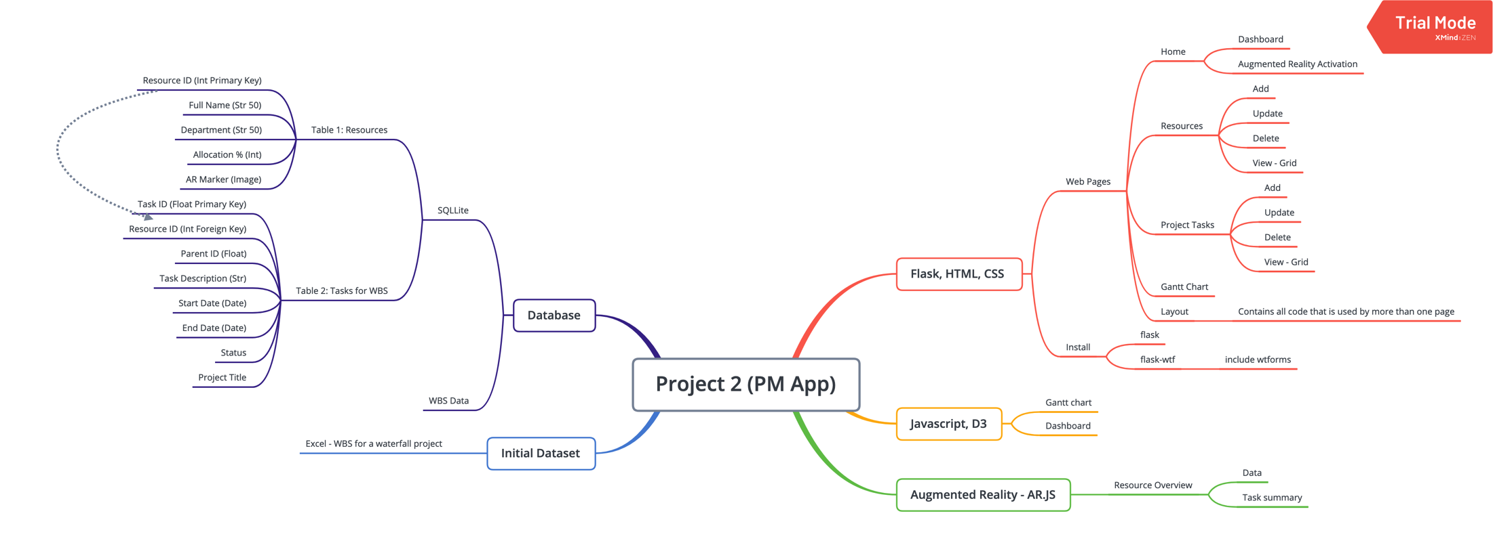
Meeting the Project Requirements

Slide 5
Meeting Project Requirements (continued)
Flask, HTML, CSS
Web pages (all user driven interaction):
Home: Dashboard; Augmented Reality
Resources: Add; Update; View
WBS: Add; Update: View
Other Charts: Gantt Chart
2. Javascript, D3
Dashboard (User driven interaction, and multiple views)
Gantt Chart
3. Database
SQLLite: Tables
Resources
Tasks
4. Dataset
WBS dataset with 200+ records
5. JS library not used before:
Ar.js

Slide 6
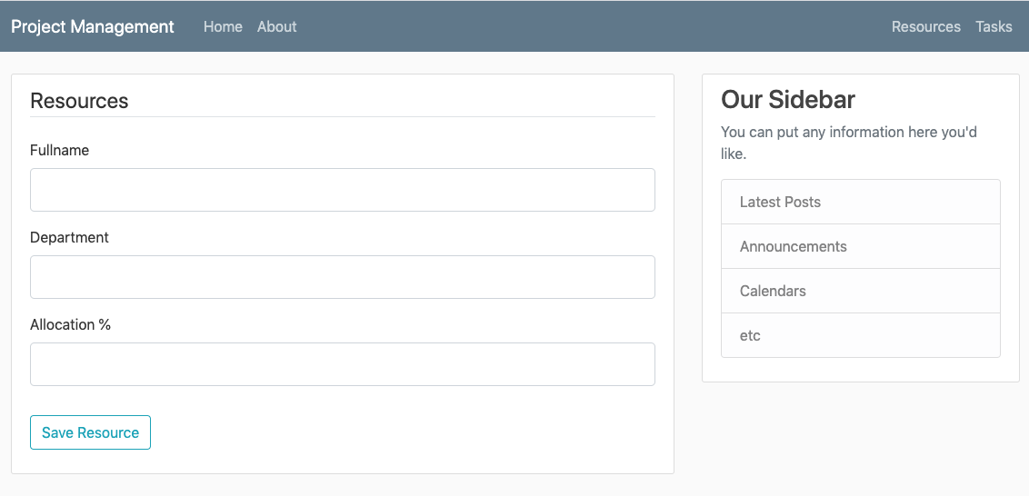
Resources Input Page

Slide 7
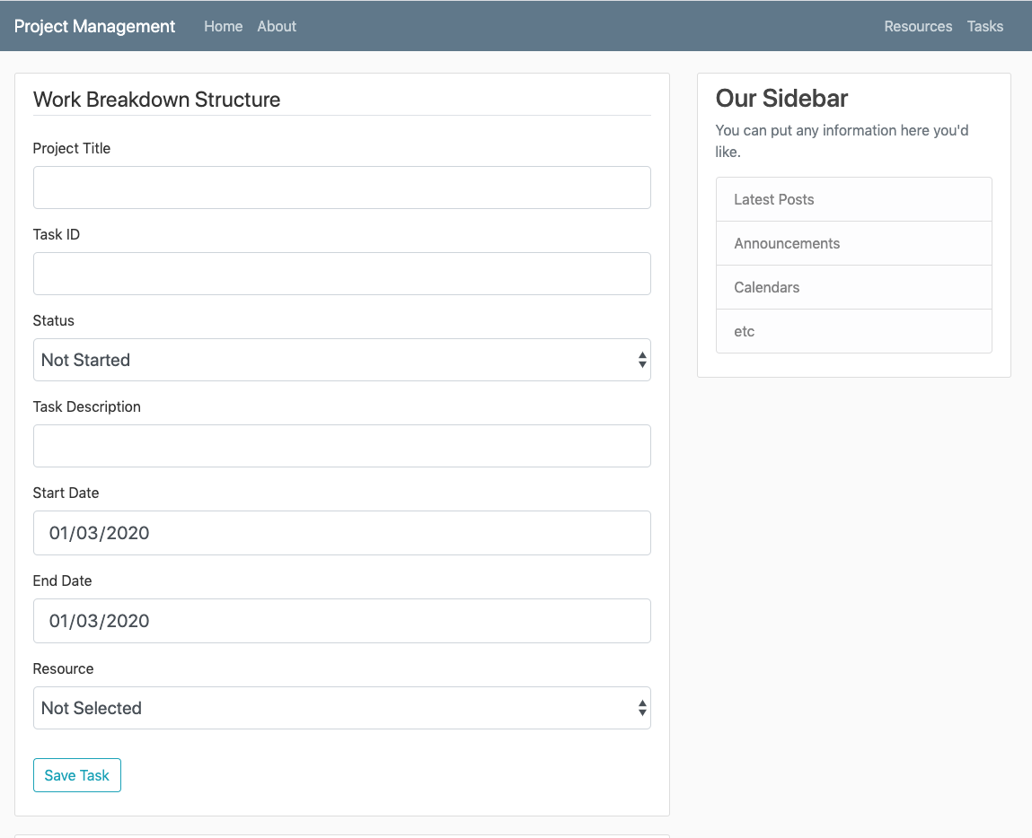
Tasks Input Page

Slide 8
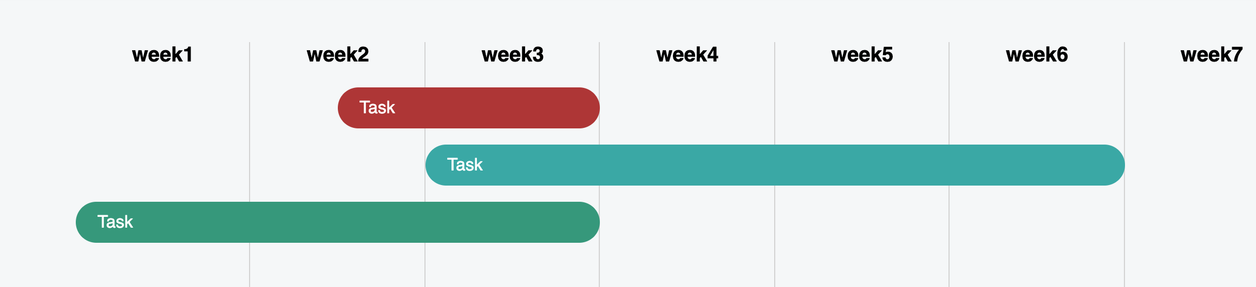
Simple Gantt Chart

